Slide 1
ALDAR University College
School of Engineering and Technology
I/O Interfacing
Dr. Osama Hosameldeen

Slide 2
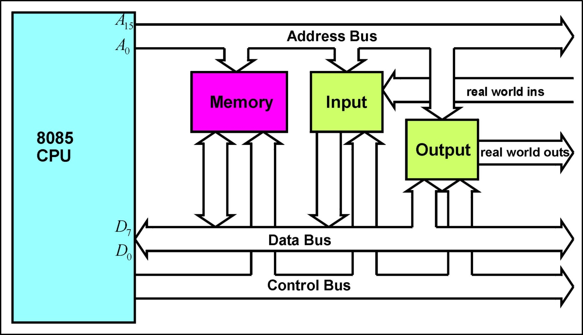
8085 Microprocessor System Block Diagram

Slide 3
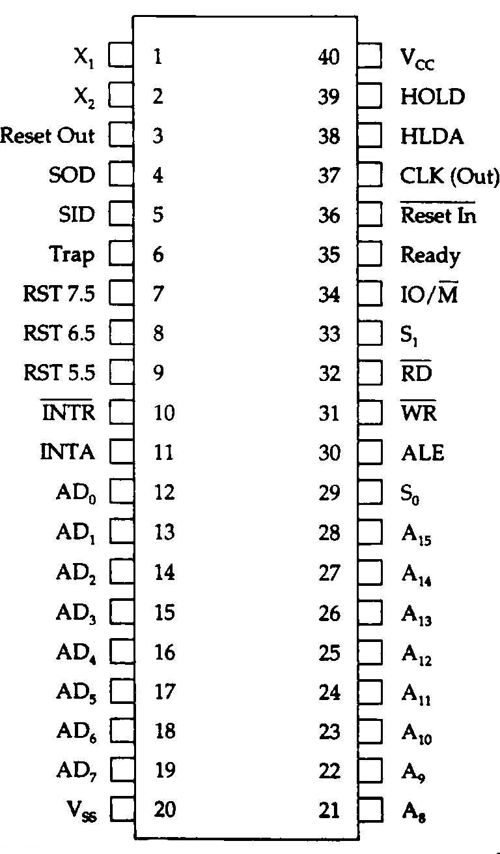
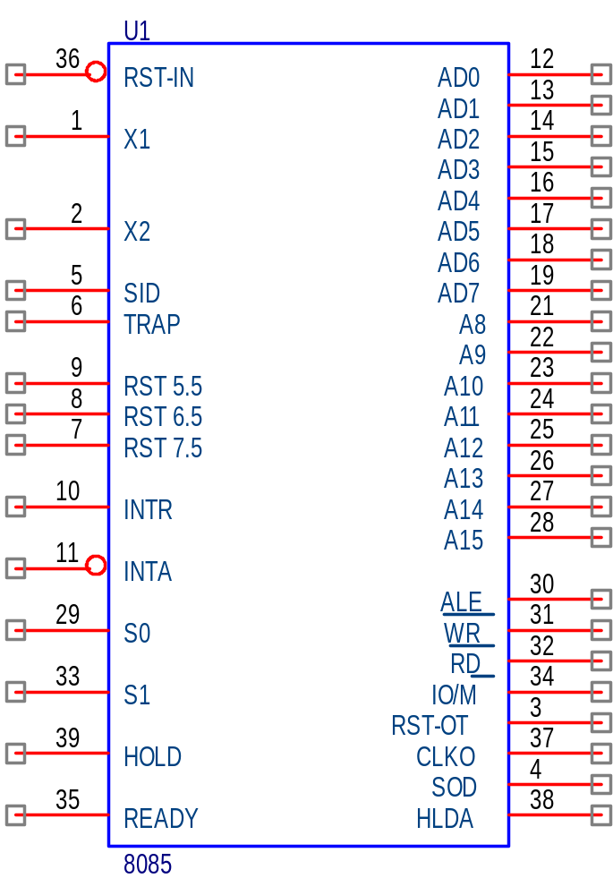
8085 CPU

Slide 4
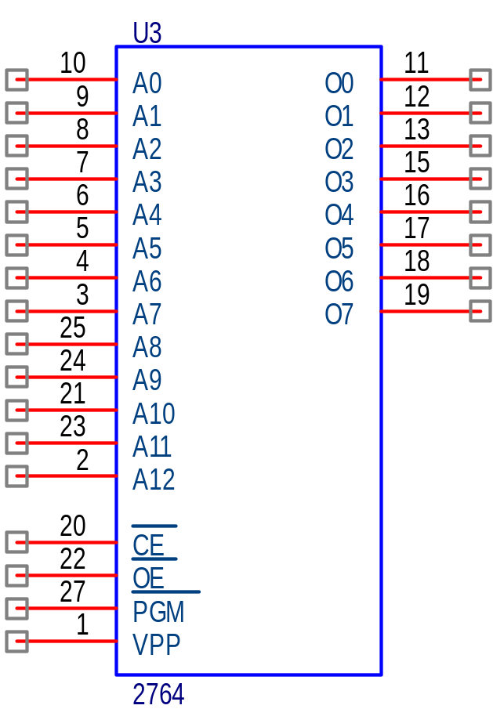
Memory EPROM

Slide 5
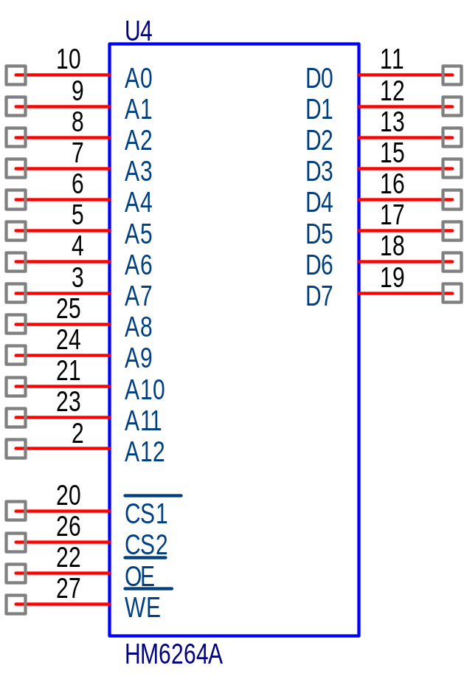
Memory RAM

Slide 6
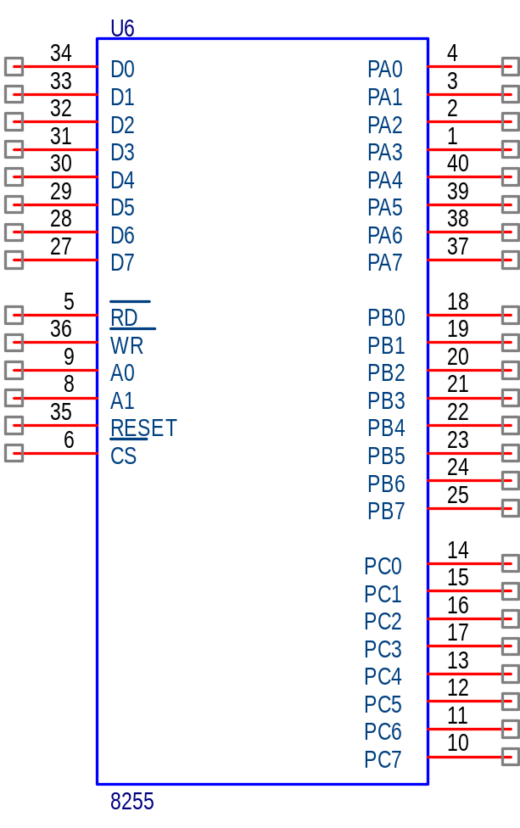
I/O 8255

Slide 7
ROM & RAM Size
ROM size 8K x 8 bit
13 bit address line A0 - A12
2¹³ = 8192 (0000H - 1FFFH)
RAM size 8K x 8 bit
13 bit address line A0 - A12
2¹³ = 8192 (0000H - 1FFFH)

Slide 8
Memory Map
0000H
ROM
1FFFH
2000H
RAM
3FFFH
4000H
Not Used
FFFFH

Slide 9
Address Decoding
A15..A12 A11..A8 A7..A4 A3..A0
ROM 0 0 0 0 0 0 0 0 0 0 0 0 0 0 0 0
0 0 0 1 1 1 1 1 1 1 1 1 1 1 1 1
RAM 0 0 1 0 0 0 0 0 0 0 0 0 0 0 0 0
0 0 1 1 1 1 1 1 1 1 1 1 1 1 1 1
Note: ROM A13 = 0 , RAM A13 = 1
Memory access, signal IO/M = 0

Slide 10
Implementation of Address Decoders
Using random logic
Using logic gates such as AND, OR, NOT and etc.
Using M-Line to N-Line Decoder
Use existing general decoders such as 74LS138, 74LS154 and etc.
Using PAL or FPGA
Using Programmable logic array devices such as PAL22V10 , PAL16L8 or Field Programmable Gate Array, ie XILINK.

Slide 11
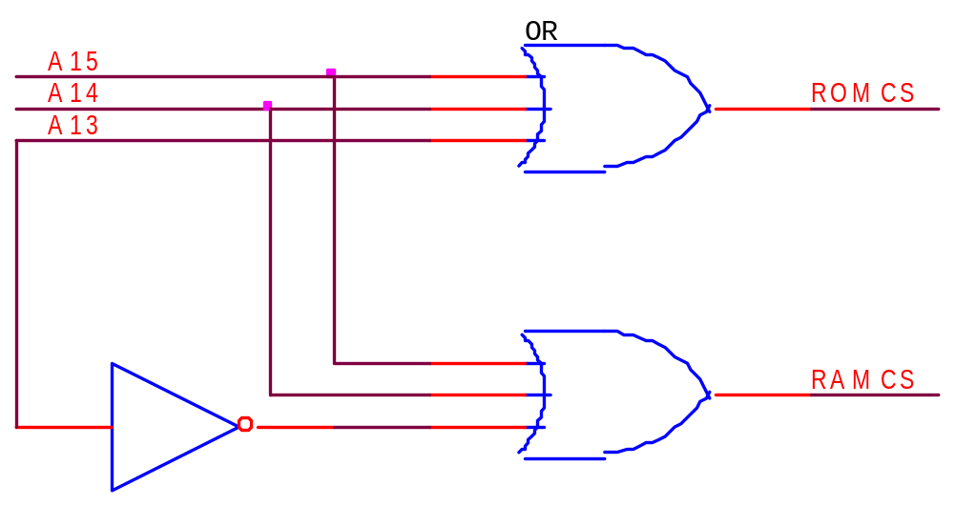
Memory Decoding Using Random Logic

Slide 12
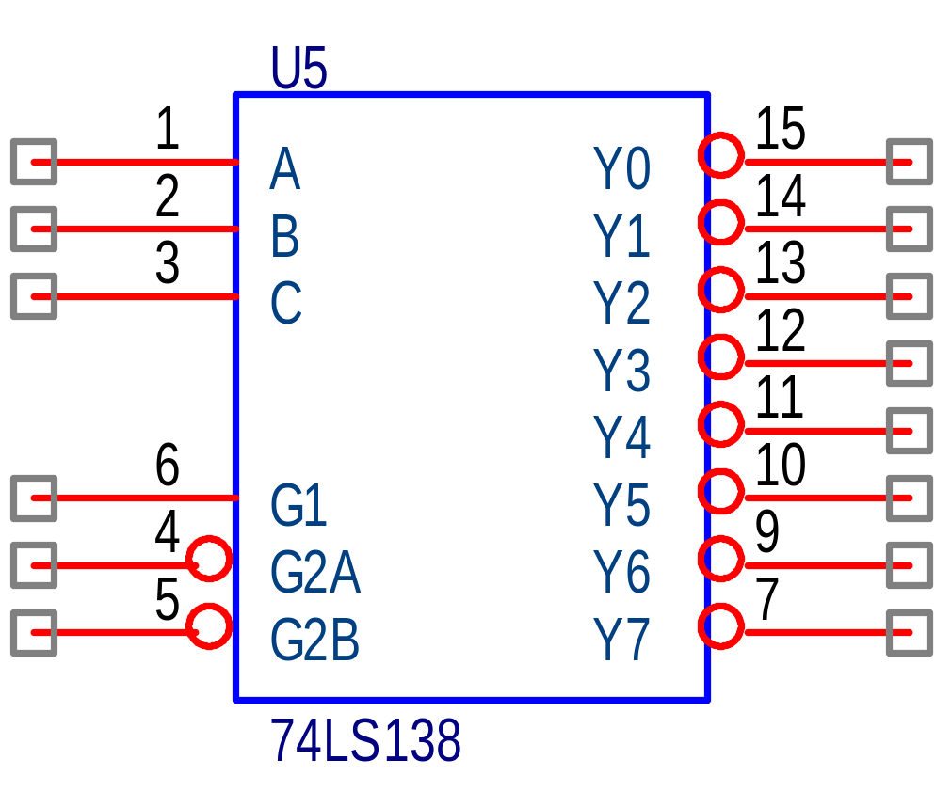
3 to 8 Decoder

Slide 13
Truth Table 74LS138
C B A G1 G2A G2B Y0 Y1 Y2 Y3 Y4 Y5 Y6 Y7
XXX 0 X X 1 1 1 1 1 1 1 1
XXX 1 1 X 1 1 1 1 1 1 1 1
XXX 1 0 1 1 1 1 1 1 1 1 1
0 0 0 1 0 0 0 1 1 1 1 1 1 1
0 0 1 1 0 0 1 0 1 1 1 1 1 1
0 1 0 1 0 0 1 1 0 1 1 1 1 1
0 1 1 1 0 0 1 1 1 0 1 1 1 1
1 0 0 1 0 0 1 1 1 1 0 1 1 1
1 0 1 1 0 0 1 1 1 1 1 0 1 1
1 1 0 1 0 0 1 1 1 1 1 1 0 1
1 1 1 1 0 0 1 1 1 1 1 1 1 0

Slide 14
Decoder connections
A13
A14
A15
ROM CS
RAM CS
+5V
IO/M
GND

Slide 15
I/O Map
00H
Not Used
7FH
80H
I/O 8255
83H
Not Used
FFH

Slide 16
I/O Address Decoding
A7..A4 A3..A0
PORT A 1 0 0 0 0 0 0 0
PORT B 1 0 0 0 0 0 0 1
PORT C 1 0 0 0 0 0 1 0
CNTL PORT 1 0 0 0 0 0 1 1
Note: I/O access, signal IO/M = 1

Slide 17
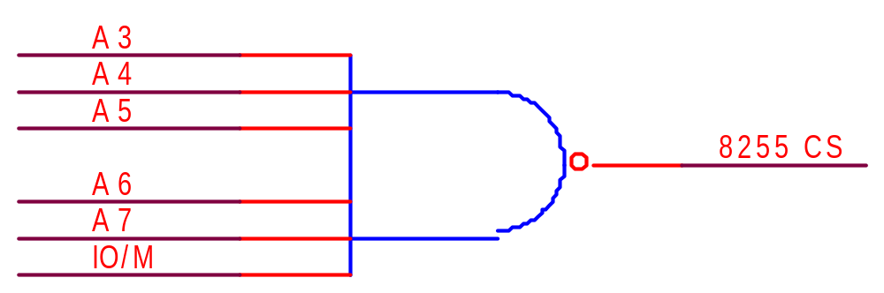
I/O Decoding Using Random Logic

Slide 18
Reset
Microprocessor must be reset in order to fetch the first instruction (T_{R} state).
The microprocessor is automatically reset at power on by an RC circuit connected to the /RESET IN (active low) input of the 8085.
For proper resetting, the /RESET IN input must remain at logic 0 for three clock pulses.

Slide 19
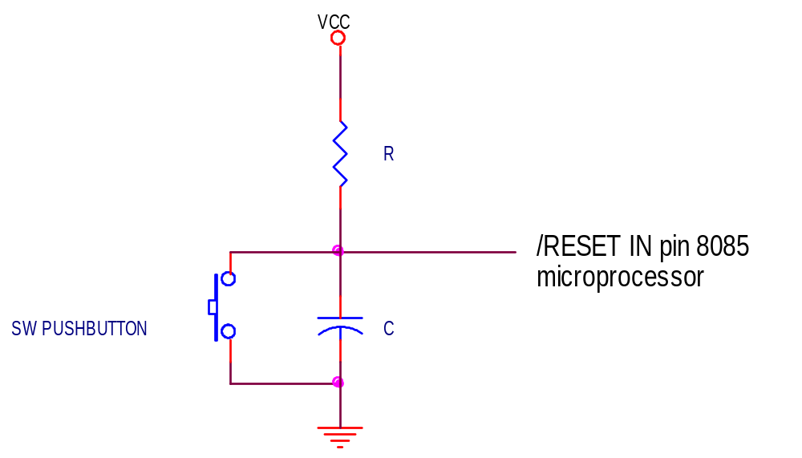
Reset Circuit

Slide 20
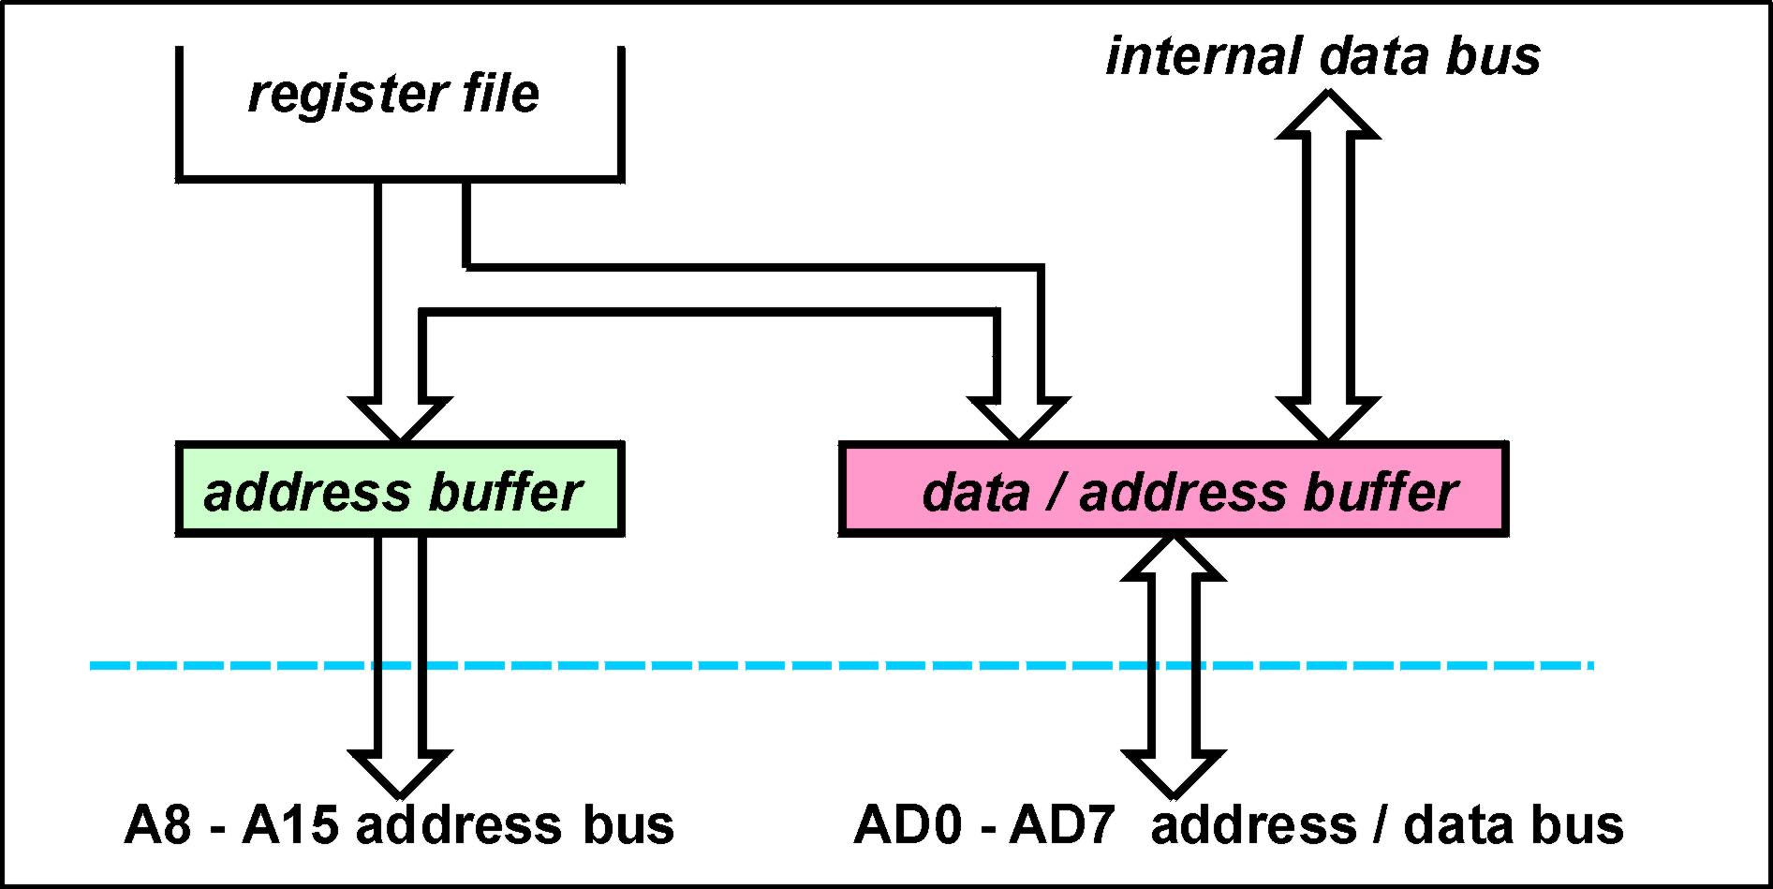
8085A Bus Interfaces
The 8085A microprocessor uses only 16 connections to interface the 8-bit data bus and 16-bit address bus.
Address bus lines A₀-A₇ are time multiplexed with data bus lines D₀-D₇

Slide 21
Address Latches
Peripheral devices ( memory and IO ) require stable address data throughout a read or write operation.
The processor only provides A0 - A7 during the period ALE is in the logic ‘1’ state after which the multiplexed lines AD0 - AD7 assume the role of the data bus. ( D0 - D7 )
To provide external devices with stable address data throughout a read or write operation it is necessary to latch the low byte of the address using the ALE control signal.
By this mechanism it is possible for the 8085A computer system to have a 16-bit address bus and an 8-bit data bus whilst only using 16 processor connections ( AD0 - AD7 and A8 - A15 )

Slide 22
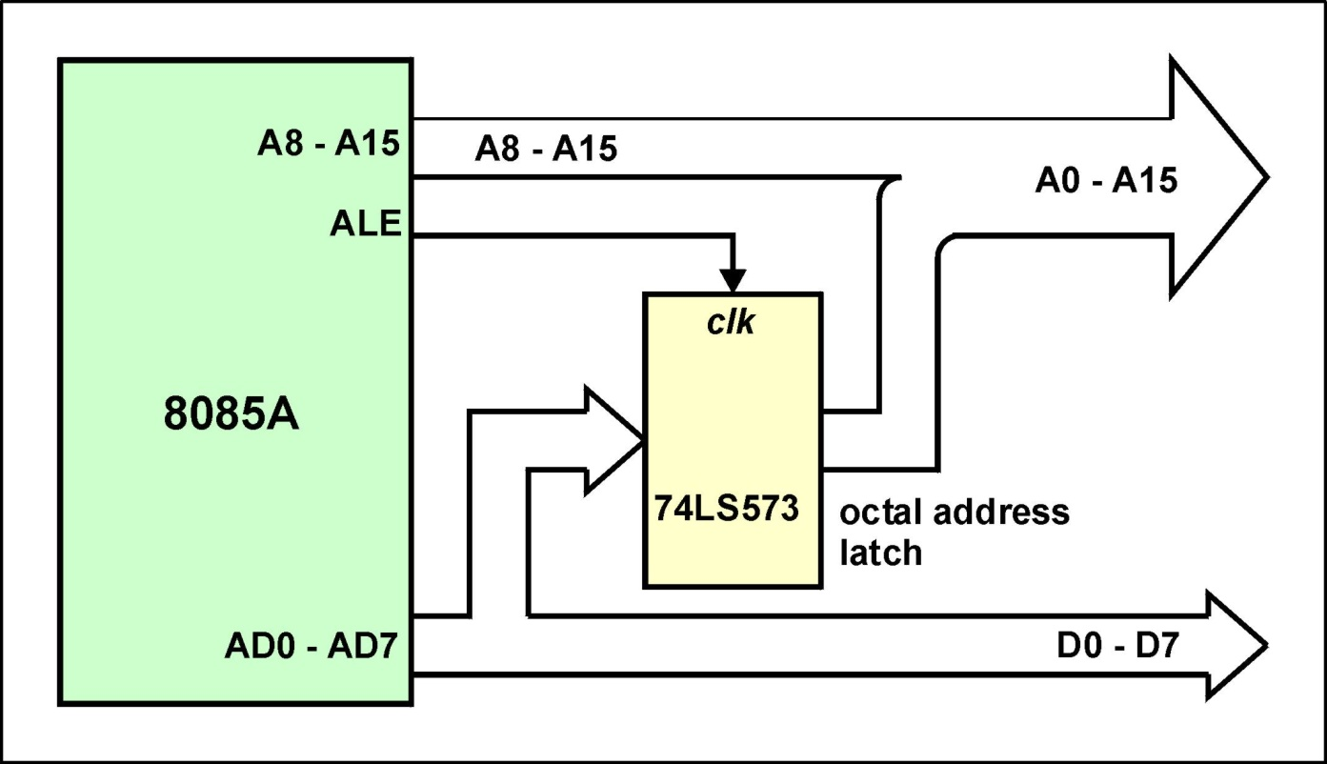
De-multiplexing AD0 - AD7
Note : See through latches ( eg 74LS573 ) are the preferred type of latch. When clk (ALE) is logic ‘1’ the latch outputs follow the inputs and on the negative edge of clk the data is latched.

Slide 23
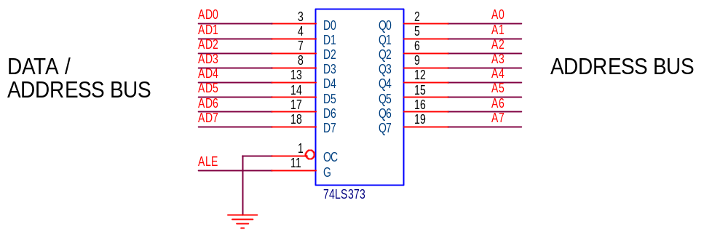
De-multiplexing AD0 - AD7

Slide 24
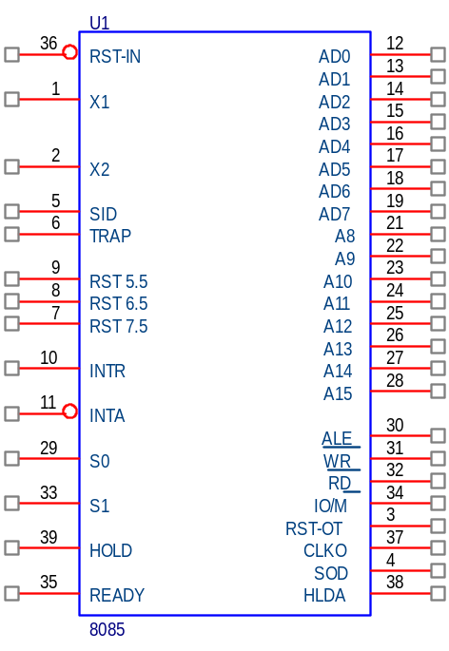
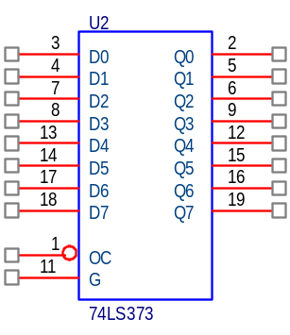
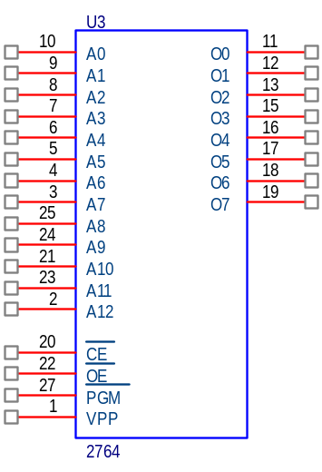
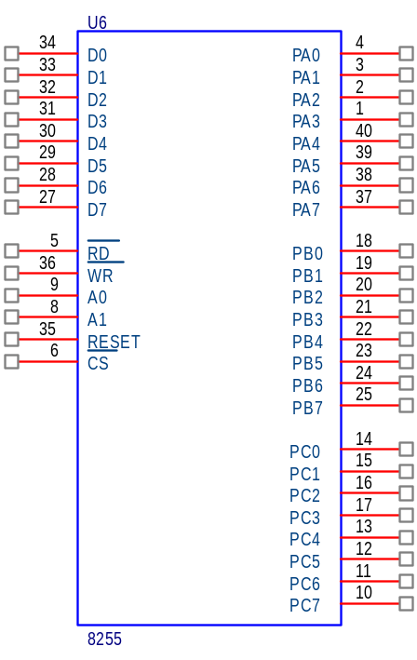
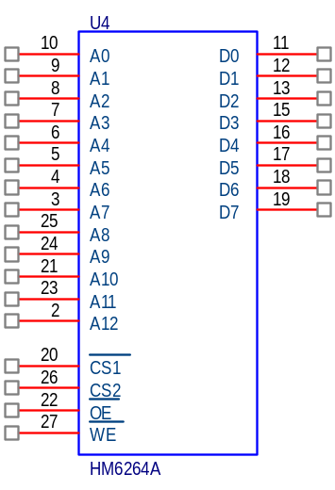

Slide 25
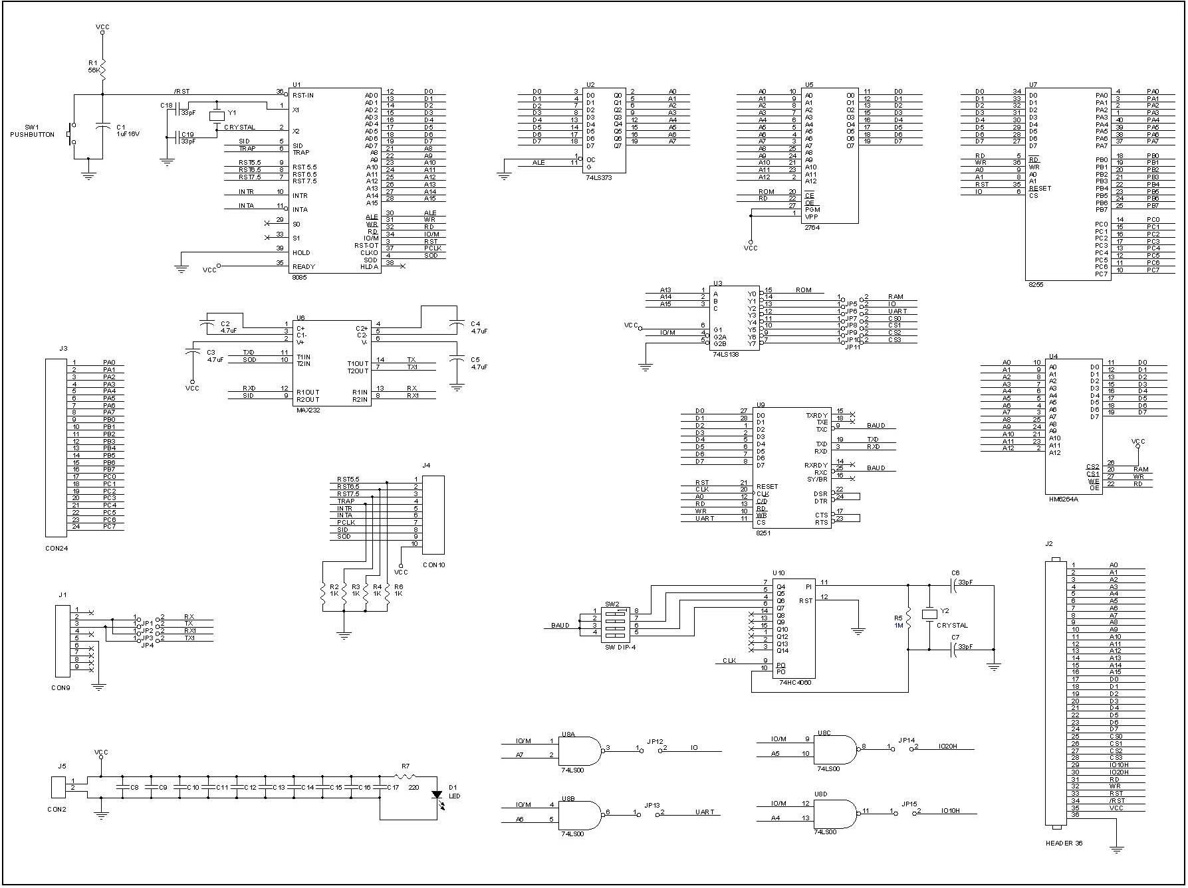

Slide 26
Exercise

